Slide 1
Implementing BRAHMA: A Loop-Free Program Synthesizer

Slide 2
Outline
Overview
Implementation
results
Advantage over 3 PS Dimentions
Building 4 main components
Cegis-based Algorithm
Working with Z3
Future Intentions
Any Questions?

Slide 3
Brahma Pros over 3 PS Dimensions
Motivation
Behavioral
Constraints
Structural
Constraints
Search
Strategies
Using base components:
Useful for hardware developers
Scalable verification of modular-designed systems
Program is correct by construction

Slide 4


Brahma Pros over 3 PS Dimensions
Motivation
Behavioral
Constraints
Structural
Constraints
Search
Strategies
Bitvector programs:
Hard to discover; even for experts
Can reduce vulnerability in software:
$$(x+y)/2$$
$$\left(x | y\right)−(\left(x⊕y\right)≫1)$$
Sensitive to overflow!

Slide 5
Brahma Pros over 3 PS Dimensions
Motivation
Behavioral
Constraints
Structural
Constraints
Search
Strategies
Leveraging constraint-based search:
Way much better than enumerative search
Exploitation of the SAT and SMT solvers strength

Slide 6











Building the constraints (An Example)
Methods
$$^$$
$$($$
$$^$$
$$→$$
$${\text{φ}}_{spec}(\vec{I}, O)$$
$$)$$
$${\text{ψ}}_{wfp}(L)$$
$${\text{φ}}_{lib}(T)$$
$${\text{ψ}}_{conn}(\vec{I}, O, T, L)$$
P1(x) : Turn-off the rightmost 1 bit
$$0011100$$
$$0011000$$

Slide 7
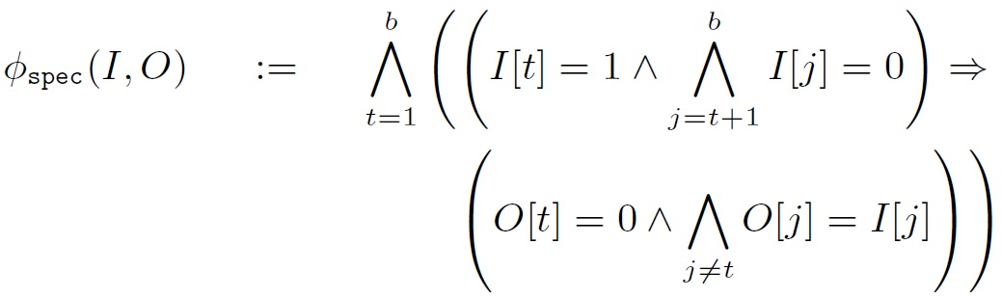

Building the constraints (An Example)
Methods
$$^$$
$$($$
$$^$$
$$→$$
$${\text{φ}}_{spec}(\vec{I}, O)$$
$$)$$
$${\text{ψ}}_{wfp}(L)$$
$${\text{φ}}_{lib}(T)$$
$${\text{ψ}}_{conn}(\vec{I}, O, T, L)$$

Slide 8
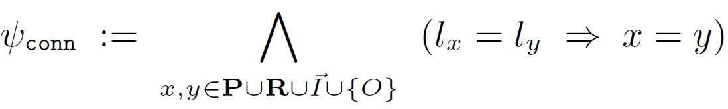

Building the constraints (An Example)
Methods
$$^$$
$$($$
$$^$$
$$→$$
$${\text{φ}}_{spec}(\vec{I}, O)$$
$$)$$
$${\text{ψ}}_{wfp}(L)$$
$${\text{φ}}_{lib}(T)$$
$${\text{ψ}}_{conn}(\vec{I}, O, T, L)$$

Slide 9

Building the constraints (An Example)
Methods
$$^$$
$$($$
$$^$$
$$→$$
$${\text{φ}}_{spec}(\vec{I}, O)$$
$$)$$
$${\text{ψ}}_{wfp}(L)$$
$${\text{φ}}_{lib}(T)$$
$${\text{ψ}}_{conn}(\vec{I}, O, T, L)$$

Slide 10
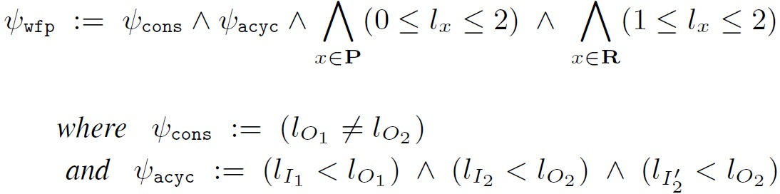

Building the constraints (An Example)
Methods
$$^$$
$$($$
$$^$$
$$→$$
$${\text{φ}}_{spec}(\vec{I}, O)$$
$$)$$
$${\text{ψ}}_{wfp}(L)$$
$${\text{φ}}_{lib}(T)$$
$${\text{ψ}}_{conn}(\vec{I}, O, T, L)$$

Slide 11
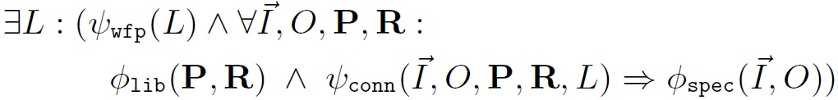
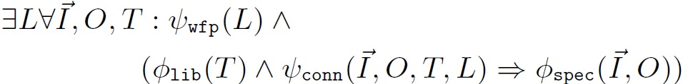
Building the constraints (An Example)
Methods
$$^$$
$$($$
$$^$$
$$→$$
$${\text{φ}}_{spec}(\vec{I}, O)$$
$$)$$
$${\text{ψ}}_{wfp}(L)$$
$${\text{φ}}_{lib}(T)$$
$${\text{ψ}}_{conn}(\vec{I}, O, T, L)$$

Slide 12
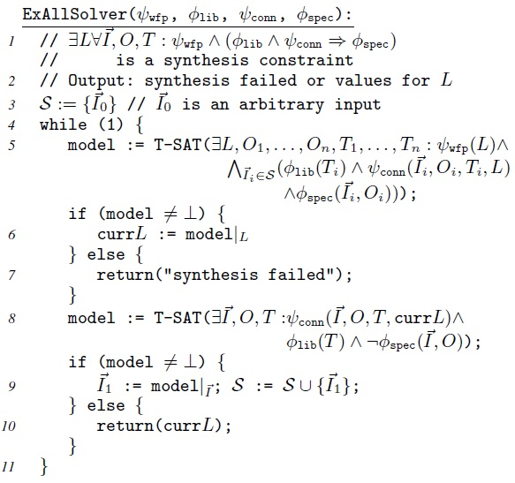
Iterating Through Inputs (Cegis-Based Algorithm)
Methods

Slide 13
OUR WORKS…
Intentions

Slide 14
OUR WORKS…
Intentions

Slide 15
EXAMPLE:
results

Slide 16
Outline
Motivation
Methods
Intentions
Advantage over 3 PS Dimentions
Building 4 main components
Cegis-based Algorithm
Working with Z3
Future Intentions
Any Questions?

